Slide 1
EE122B
Introduction to Biomedical Electronics
Hemodynamics
Greg Kovacs, Laurent Giovangrandi
Department of Electrical Engineering
Stanford University

Slide 2
Content
Basic cardiovascular physiology concepts and methods of evaluating CV parameters.
Cardiovascular physiology concepts
Blood Pressure measurements
  Invasive
  Non-invasive
Flow & Volume Measurements
  Invasive
  Non-invasive
Acoustic Measurements
Notes:
No ultrasound!

Slide 3
Cardiac Physiology
Science

Slide 4
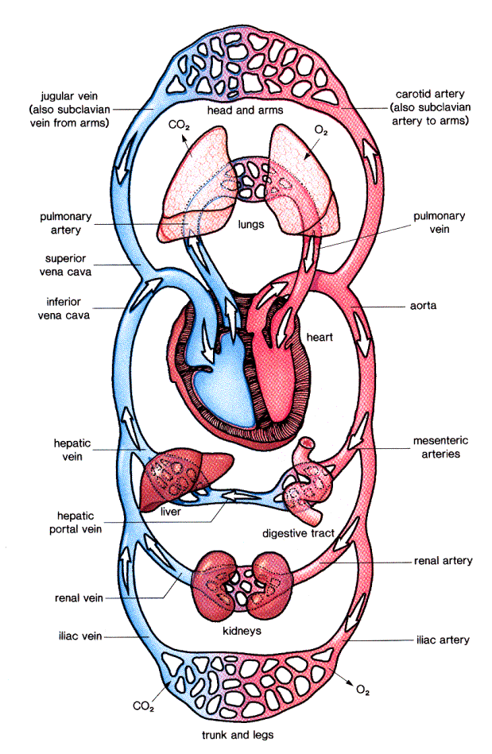

The Cardiovascular System
Main functions:
Deliver nutrients and oxygen to the body tissue
Remove waste products
Remove heat
Composed of three main systems:
Systemic (body)
Pulmonary (lungs)
Coronary (heart)
http://faculty.plattsburgh.edu/david.curry/NUR464/Circul2.gif
http://www.hhmi.org/biointeractive/animations/
Notes:
1628 William Harvey, an English Physician, first describes blood circulation
Define veins, arteries, chambers, valves,…
Veins: returning to heart
Arteries: leaving heart
Blue: de-oxigenated
Red: oxigenated

Slide 5
Cardiovascular System – Basic Facts
Blood volume is about 8% of body weight (5 l for a 70 kg person).
Heart pumps 5 - 30 liters of blood per minute.
Heart beats over 2 billion times over a lifetime.
Total length of circulatory system > 100’000 km !
Vessel diameters span more than three orders of magnitude (aorta ~ 2-3 cm, capillaries ~5-10 μm).
Approx. 70 million Americans have cardiovascular diseases.
Accounts for 38% of all deaths!
Notes:
27 million > 65 years old.
High blood pressure = 65 million
Coronary heart disease = 13 million
Myocardial infarction = 7.1 million
Angina (chest pain) = 6.4 million
Congestive heart failure = 4.9 million
Stroke = 5.4 million
Congenital defects = 1 million
Leading cause of death since 1900 (except 1918)
Roughly equals death due to cancer, respiratory diseases, accidents, diabetis, flu, pneumonia COMBINED
From American Heart Association Heart Disease and Stroke Statistics - 2005 Update
(www.americanheart.org)

Slide 6
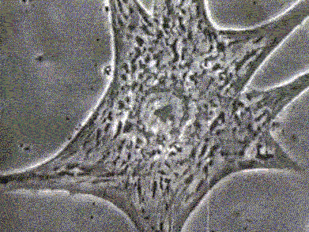
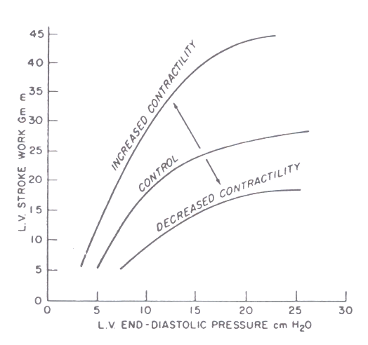
Cardiac Pump
The heart is non-sucking, intermittent outflow, continuous inflow pump.
If no pressure at the inlet, no flow !
In addition, the more blood goes in, the harder the heart
contracts (up to a certain point). This is the Frank-Starling
law of the heart (related to myocyte physiology).
Cardiac cycle – two phases:
Diastole: Relaxation phase (filling of ventricles)
Volume at the end of filling is the preload
(related to venous return and venous
pressure).
Systole: Contraction phase (ejection)
Push against an afterload, related to aortic
pressure.
“output”
“preload”
Source: http://www.turbulence.org/Works/genresponse/heartbeat.gif
http://www.pharmacology2000.com/cardiac/cardiac1.htm
Notes:
This is why the pressure are so important in the body. It not only determines what against the heart has to push (afterload), but also what will fill the heart and ‘arm’ it (pre-load).
The atria buffer the continuous incoming flow from the vein when the ventricles are contracting.
Make the link with the respiration, reducing blood flow, thus increasing heart rate

Slide 7
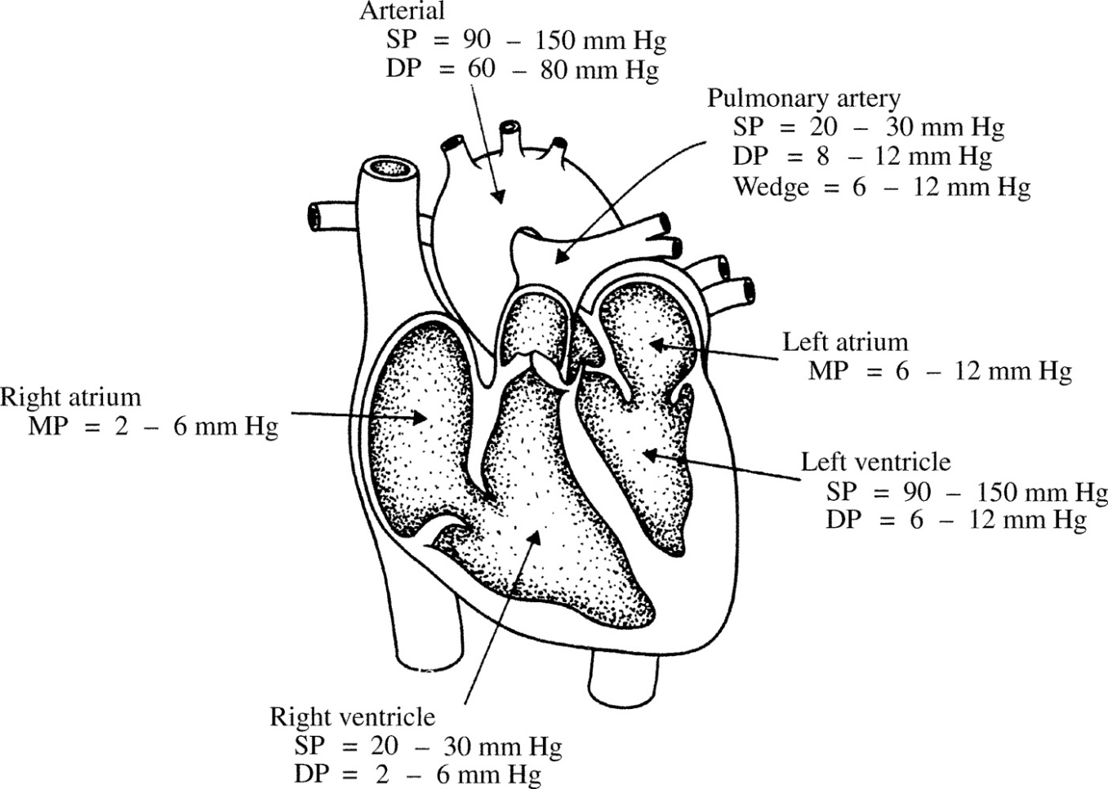
Cardiac Pump – Typical Values
Parameter | Average @ 85% | Lance Armstrong
End-diastolic volume (EDV)
End-systolic volume (ESV)
Stroke volume (SV) | 70 ml | 200 ml
Ejection fraction (E_{f})
Heart rate (HR) | 156 bpm | 156 bpm
Cardiac output (CO) | 11 l/m | 31 l/min
Parameter | Average @ rest | Lance Armstrong
End-diastolic volume (EDV) | 120 ml
End-systolic volume (ESV) | 50 ml
Stroke volume (SV) | 70 ml | 200 ml
Ejection fraction (E_{f}) | 58%
Heart rate (HR) | 72 bpm | 32 bpm
Cardiac output (CO) | 5.04 l/m | 6.4 l/min
Typical systemic arterial blood pressures
Aortic valve
Pulmonary valve
Mitral valve
Parameter | Average @ 100% | Lance Armstrong
End-diastolic volume (EDV)
End-systolic volume (ESV)
Stroke volume (SV) | 70 ml | 200 ml
Ejection fraction (E_{f})
Heart rate (HR) | 184 bpm | 200 bpm
Cardiac output (CO) | 12.8 l/m | 40 l/min
Tricuspid valve
Parameter | Average @ rest
End-diastolic volume (EDV) | 120 ml
End-systolic volume (ESV) | 50 ml
Stroke volume (SV) | 70 ml
Ejection fraction (E_{f}) | 58%
Heart rate (HR) | 72 bpm
Cardiac output (CO) | 5.04 l/m
Note: 1 mm Hg = 133 Pa
100 mm Hg = 2 psi (lb/in²)
Notes:
Define a few things (stroke volume, ejection fraction,…)
Valve: Atrio-ventricular (bicuspid/mitral - left, tricuspid - right), Aortic valve (left), Pulmonary valve (right)
Note that heart pressures are very useful for diagnostic purposes.
Lance Armstrong vs average
Rest:
HR 32 bpm 75 bpm
SV 200 ml 70 ml
CO 6.4 l/min 5.2 l/min
@ 85% max exercise
HR 156 bpm 156 bpm
SV 200 ml 70 ml
CO 31 l/min 11 l/min
@100%, Alpes d’huez…
HR 200 bpm 184 bpm
SV 200 ml 70 ml
CO 40 l/min 12.8 l/min
VO2 max 84 ml/kg/min 40 ml/kg/min
Miguel Indurain: resting HR = 28bpm, CO = 50l/min at max

Slide 8
Cardiac Pump – Atypical Values
Parameter | Average @ rest | Lance Armstrong
End-diastolic volume (EDV) | 120 ml
End-systolic volume (ESV) | 50 ml
Stroke volume (SV) | 70 ml | 200 ml
Ejection fraction (E_{f}) | 58%
Heart rate (HR) | 72 bpm | 32 bpm
Cardiac output (CO) | 5.04 l/m | 6.4 l/min
Average @ 85% | Lance Armstrong
70 ml | 200 ml
156 bpm | 156 bpm
11 l/m | 31 l/min
Average @ 100% | Lance Armstrong
70 ml | 200 ml
184 bpm | 200 bpm
12.8 l/m | 40 l/min
Miguel Indurain: resting HR = 28bpm, CO = 50l/min at HR max
Notes:
Define a few things (stroke volume, ejection fraction,…)
Valve: Atrio-ventricular (bicuspid/mitral - left, tricuspid - right), Aortic valve (left), Pulmonary valve (right)
Note that heart pressures are very useful for diagnostic purposes.
Lance Armstrong vs average
Rest:
HR 32 bpm 75 bpm
SV 200 ml 70 ml
CO 6.4 l/min 5.2 l/min
@ 85% max exercise
HR 156 bpm 156 bpm
SV 200 ml 70 ml
CO 31 l/min 11 l/min
@100%, Alpes d’huez…
HR 200 bpm 184 bpm
SV 200 ml 70 ml
CO 40 l/min 12.8 l/min
VO2 max 84 ml/kg/min 40 ml/kg/min
Miguel Indurain: resting HR = 28bpm, CO = 50l/min at max

Slide 9
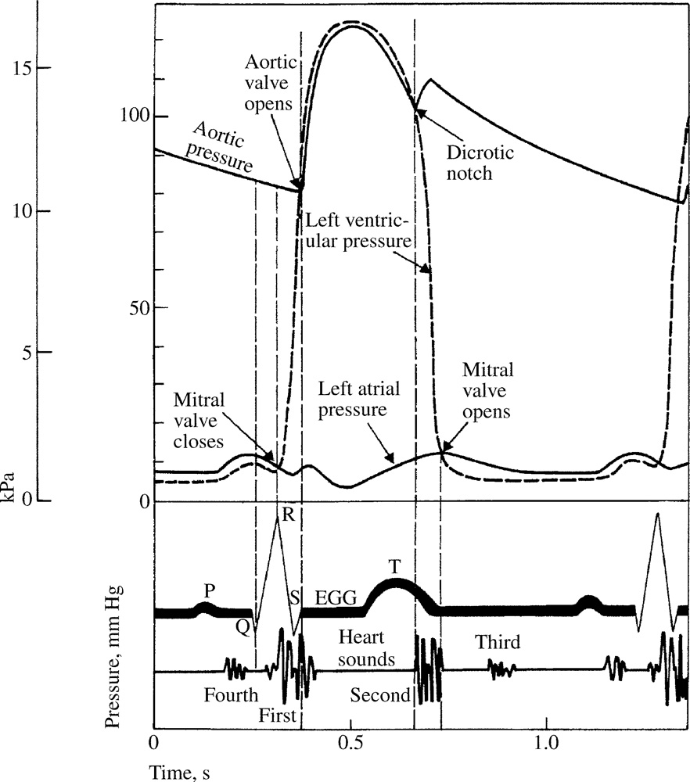
Cardiac Cycle – Wiggers Diagram
Systolic Pressure
The Wiggers diagram represents major phases and characteristics of the cardiac cycle.
Very useful for understanding relationships between pressure, flow, electrical signals and sounds.
Aortic valve closes
Diastolic
Pressure
A great Flash animation ca be found at:
http://library.med.utah.edu/kw/pharm/hyper_heart1.html
Source: Medical Instrumentation, J. Webster, Wiley, 2009
Notes:
The parameters of function measured and displayed in the Wiggers Diagram include: aortic pressure (obtained by placing a catheter and associated pressure transducer in the aorta); left ventricular pressure (obtained by placing a catheter and associated pressure transducer in the left ventricular chamber - through the aortic valve); left atrial pressure (obtained as a "wedge pressure" from a catheter inserted into the pulmonary artery from the right side of the heart); aortic blood flow (obtained by one of a variety of techniques including doppler); ventricular volume (obtained from indicator dilution techniques); heart sounds (obtained by auscultation); venous pulse (obtained by placement of a catheter and associated pressure transducer in the inferior or superior vena cava); and electrocardiogram (obtained from placement of surface electrodes).“
Dicrotic notch: aortic valve closes

Slide 10
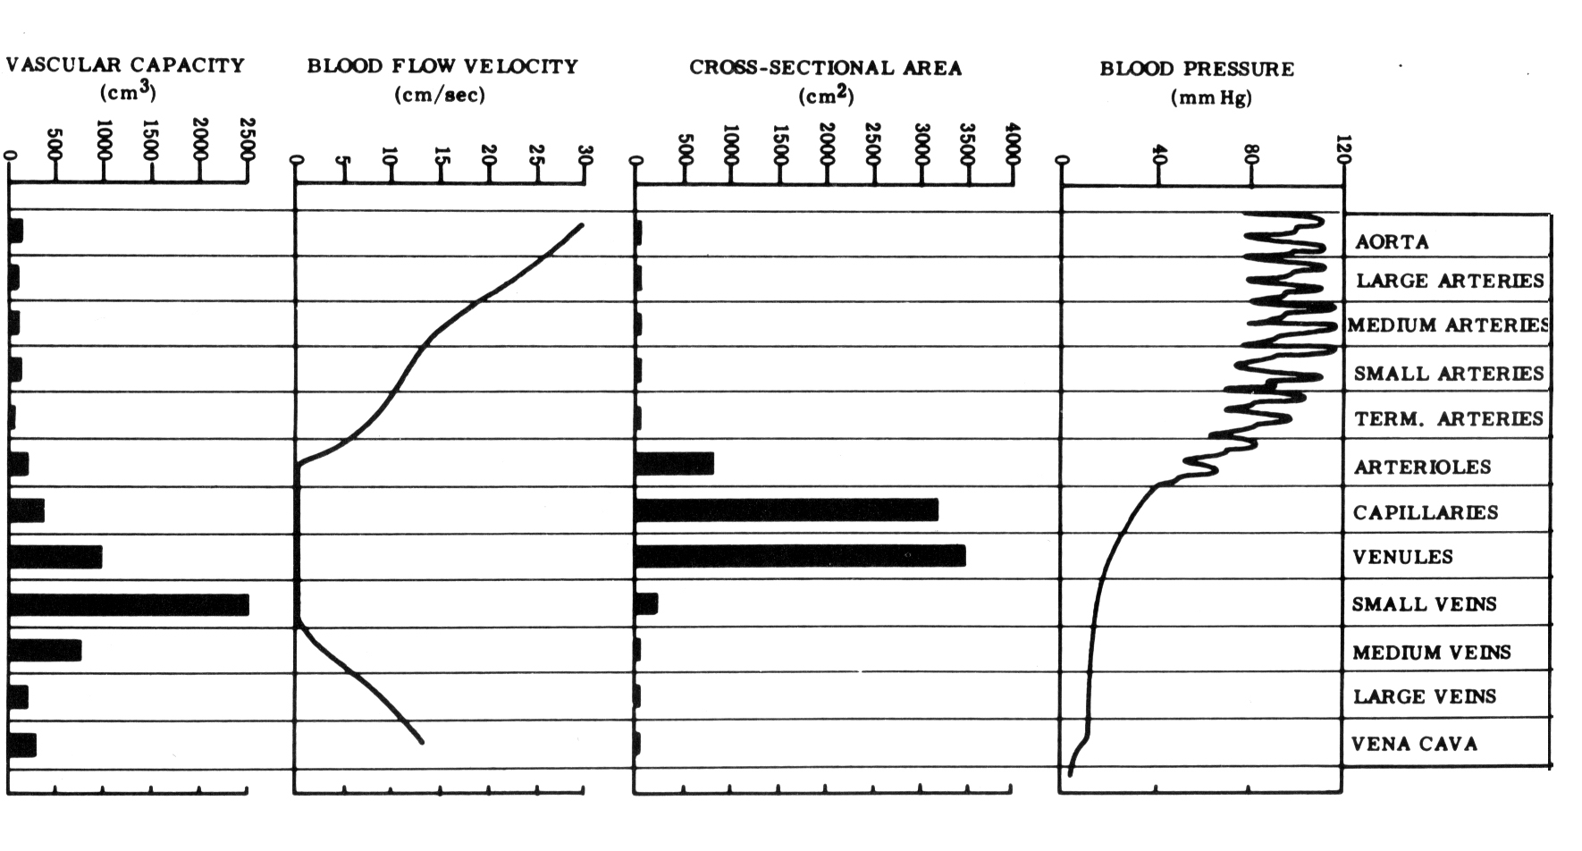
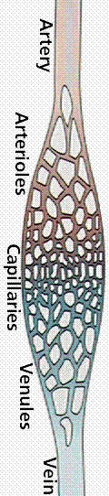
Vasculature
Vasculature is composed from arteries, capillaries, and veins.
Vessels resistance and flow can be approximated using the Poiseuille-Hagen and Darcy’s laws:
R Resistance
η viscosity
Δl length of vessel
r radius of vessel
ΔP Pressure drop
F Flow
a
Source: Figure 9-15, Cardiovascular Function, Abel & McCutcheon
Notes:
The other main player in the hemodynamics system is obviously the vasculature through which the blood flows.
The total resistance of the systemic vasculature is called Total Peripheral Resistance (TPR).
The second equation is the fluid equivalent to Ohm’s law. The average pressure associated with a mean R (TPR) and a cardiac output (flow) is the Mean Arterial Pressure (MAP).
Total flow is constant throughout the system.
Arteries have a lot of muscles and elastic fibers to withstand high pressure.
Veins are more elastic, and can store more blood

Slide 11
Arterial Vasculature and Blood Pressure
Arterial vasculature is very active in regulation of blood flow and pressure:
  Pressure (baro) and chemical (chemo) receptors in carotid and aorta regulates global blood pressure by changing vasculature resistance (vaso-constriction or –dilation), heart rate, and blood volume.
  Locally, chemoreceptors (O₂, CO₂) autoregulate blood flow to tissue, also leading to pressure change.
  Global regulation (and to some extent local too) is under the autonomic nervous system control.
Notes:
ANS: subconscious control, typically divided into two subsystems:
the parasympathetic nervous system and sympathetic nervous system
Vasodilatation and constriction is performed by smooth muscle cells in the walls of arteries, veins
Note: these three parameters are the focus on most of the hypertension drugs (betablocker – heart rate/vasodilation, diuretics – blood volume, ACE inhibitors – vasodilation/blood volume, through blockade of angiotensin conversion in the renin-angiotensin-aldosterone system (RAAS).

Slide 12
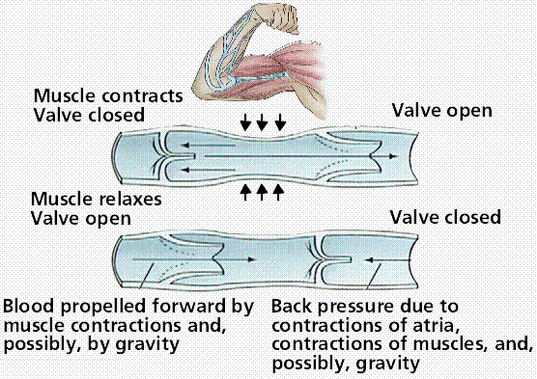
Veins
  Veins have much larger capacity than arteries (as high as 80% of total blood) due to their high elasticity.
  Very low pressure gradient, hence need for additional pumping mechanism to return blood to heart:
Source: Purves, et al., Life: The Science of Biology, 4th edition, Sinauer Associates

Slide 13
Pressure Pulse Wave
Because of the compliance (elasticity) of arteries, sudden ejection of blood at the aorta leads to local distension which travels down the arterial branches.
Pulse velocity much higher than flow velocity (>15x).
Pulse velocity increases for smaller vessels.
3-6 m/s in aorta, 15-35 m/s in arteries
Can be detected by local volume change (plethysmography).
Reflections alter waveform
Increased velocity with arterial stiffness due to age, stenosis, atherosclerosis,…
Pulse Wave
Flow
Notes:
In particular, the notch seen in PPG is not clear whether it is attributed to the dicrotic notch, or reflection waves.
Related to the Windkessel effect.
Atherosclerosis: plaque build up
Arteriosclerosis: stiffening of vessels

Slide 14
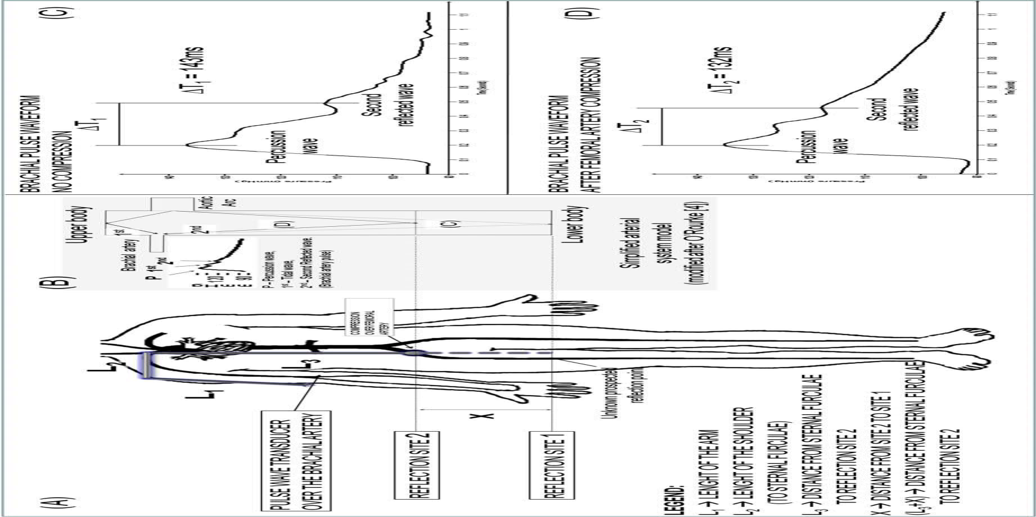
Pulse Pressure Reflections
Source: Benchimol-Barbosa PR, Barbosa-Filho J, Natural reflection site and arterial pulse wave velocity estimations based on brachial pulse wave morphology analyses, Int. J. Cardiol, 2009.
Notes:
When the femoral artery is compressed, the reflection comes back faster.

Slide 15
Blood Pressure Measurements
Measurement Techniques

Slide 16
Invasive Measurements
Invasive measurements rely on direct measurement in the blood stream.
They allow measurement of most pressures in the heart and vasculature (ventricles, atria, pulmonary artery,…).
Measurement bandwidth: DC-50Hz
Two main methods:
  Extravascular sensing
  Sensor is outside the body and connected hydraulically to the blood stream.
  Intravascular sensing
  Sensor is in the blood stream, at the tip of a catheter.

Slide 17
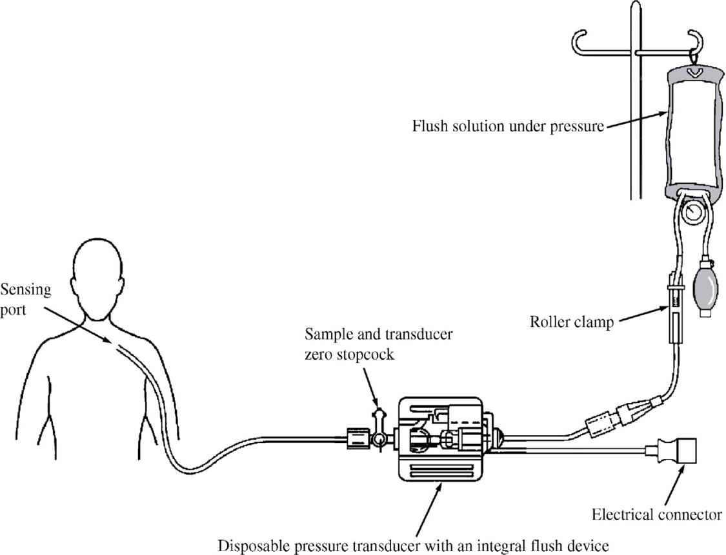
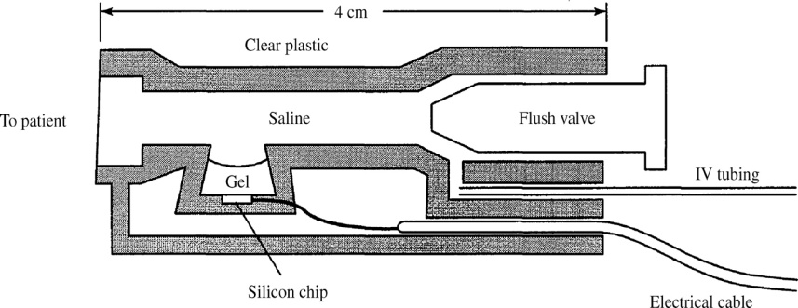
Extravascular Blood Pressure Sensing
Catheter inserted in artery or vein.
Physiological solution hydraulically connects external (disposable) sensor.
Requires careful calibration to preserve dynamic accuracy (hydraulic line introduce its own transfer function).
  Underdamping leads to
  overestimates.
  Overdamping reduces
  bandwidth.
  Air bubble leads to damping.
Sensor principle:
  Piezoresistive (strain gages)
  Capacitive
  Optical (good for MRI)
  …
Notes:
Medical market has become a huge market for pressure sensors since they use disposable ones.
Optical: membrane deflect light and attenuation is measured.

Slide 18
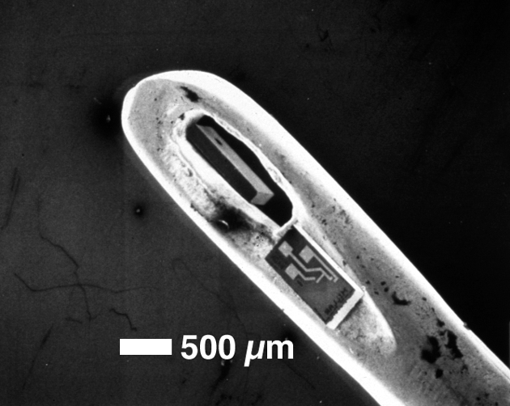
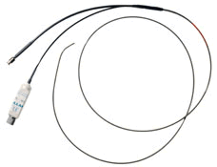
Intravascular Blood Pressure Sensing
Intravascular sensors uses a miniature pressure sensor at the tip of a catheter.
Typically, MEMS piezoresistive pressure sensors.
Catheter-Tip Pressure Sensors
Millar Mikro-Tip® pressure intravascular catheters
Courtesy of Lucas NovaSensor.
Notes:
It is made by Lucas NovaSensor in Fremont, and is used by the Millar Company to make miniaturized medical catheters for pressure sensing in the body.

Slide 19
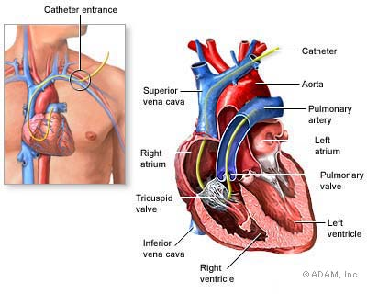
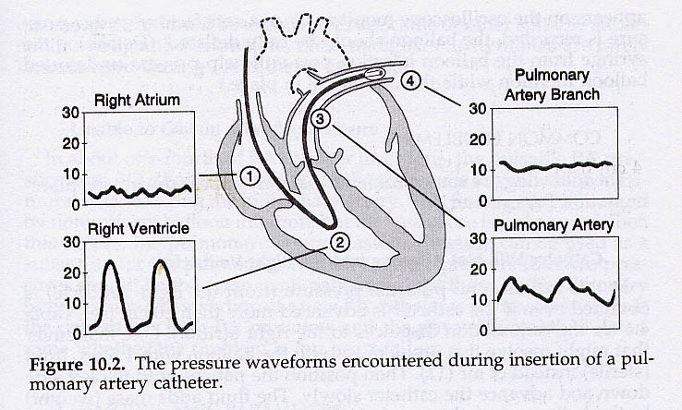
Example: Swan-Ganz Catheter
Traditional method to introduce a catheter in the right heart.
The catheter is terminated by a small balloon which is carried by the flow (flow-directed catheter).
Also used to for flow and cardiac output assessment.
Source: http://www.nytimes.com/imagepages/2007/08/01/
health/adam/18087SwanGanzcatheterization.html
Notes:
The wedge pressure is the pressure in a small pulmonary artery, once it is occluded with a balloon. The pressure in this artery is then more or less equal to the pressure in the left atrium (the pulmonary artery is filled with a stable column of blood, hence ‘sample’ the pressure at the other end – the left atrium).
Other approach are catheters guided by fluoroscopy (light X-ray with contrast agents – barium, iodine) in catheterization lab.
Left ventricular pressures can also be measured using catheters, using femoral artery as entry point. Less common, though, because more risky (higher pressures).

Slide 20
Piezoresistive Pressure Sensors
Piezoresistors change their resistance with applied stress.
Semiconductor piezoresistive effect (gauge factor) ~100 times larger than in metal, ideal for miniature silicon sensors.
Large temperature sensitivity can be a problem
Positive and negative piezoresistive coefficients allow bridge (Wheatstone) configuration.
Maximize signal while minimizing common-mode noise (e.g., temperature).
Bond Pads (Al)
Implanted
Piezoresistor
SILICON
GLASS SUBSTRATE
Source: EE312 slides, Prof. Kovacs
Notes:
CHECK!!! STRESS OR STRAIN ???
Bridge are ideally driven by a lock-in technique as we have seen before
Four times larger signal if four arms active
Gauge factor for Si: 100-170 (n-type) or –(100-140) (p-type), compared to ~2 for metal.

Slide 21
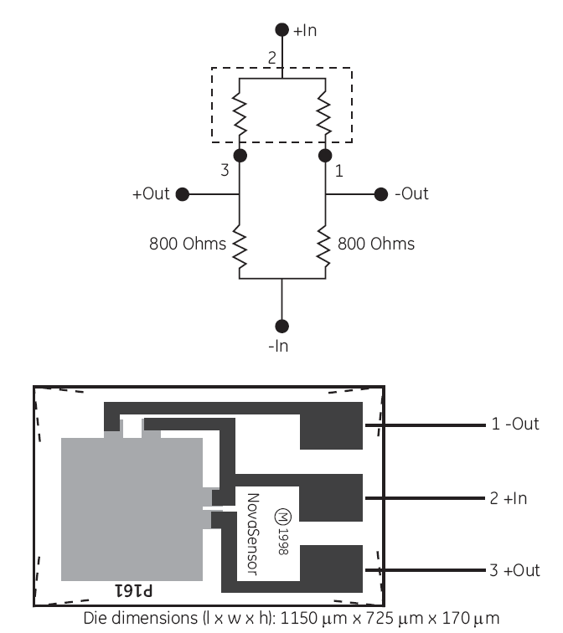
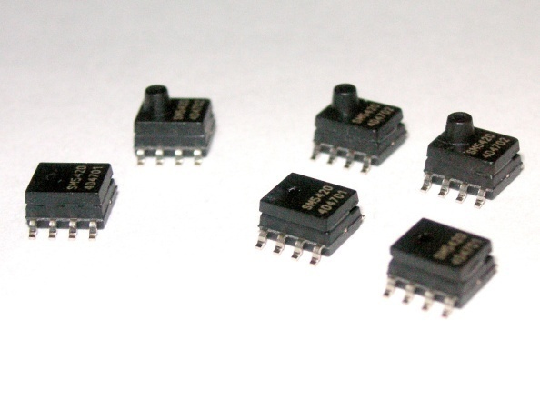
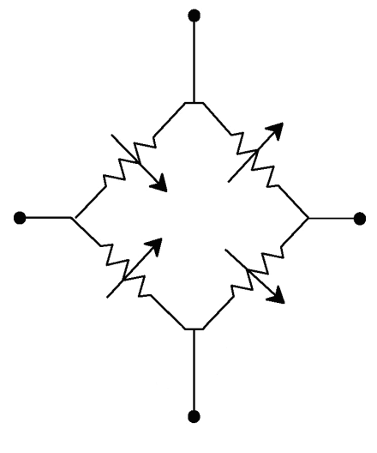
Example of Pressure Sensors
GE Novasensors NPD-240
Silicon Microstructure Low-cost SM5420C
Not for catheter!
Range: -50 to 300 mmHg
R_{bridge} = 800 Ω
Half-bridge design (need two external resistors)
Excitation voltage = 1-8 V
Range: 0-15 PSI up to 0-100 PSI
R_{bridge} = 5 kΩ
Excitation voltage = 0-10 V
Excitation current = 0-1.6 mA
Notes:
Reminder: 100mmHg = 2 psi

Slide 22
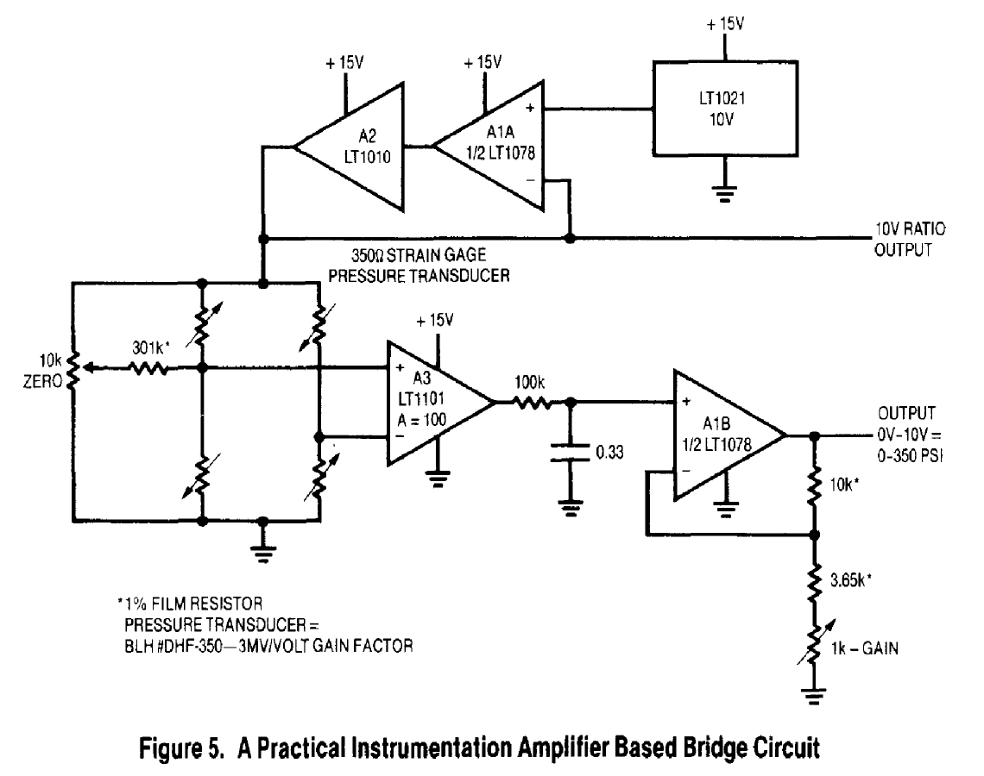
Bridge Conditioning Examples
Potential issue:
Common-mode voltage !
10V supply leads to 5V common-mode and a ~30mV signal from the pressure transducer.
For a 12-bit accuracy, CMRR must be ~120dB !
Source: Linear Technology AN-43
Notes:
Straightforward configuration
Note the manual balancing on the left
12 bit accuracy over the 30mV full range signal = 7.3 uV! Compared to 5V, it is around 120dB!!

Slide 23
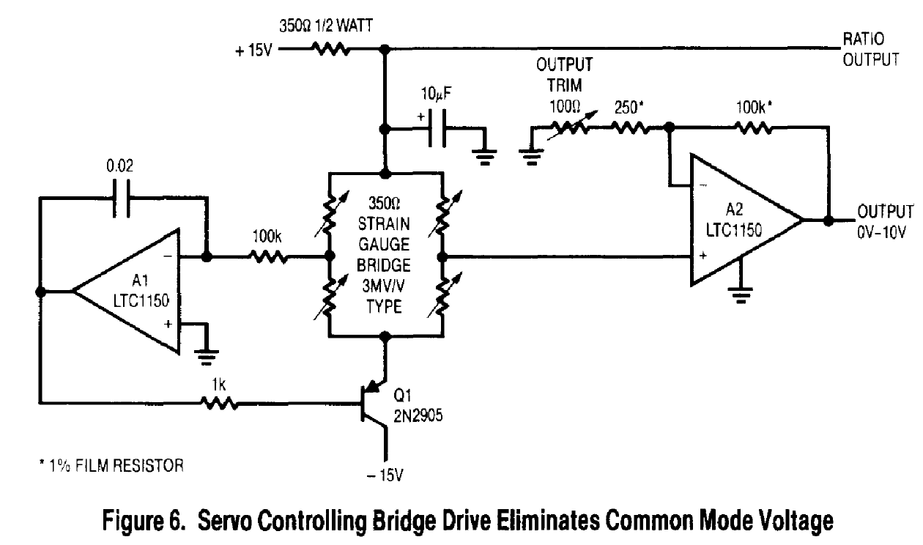
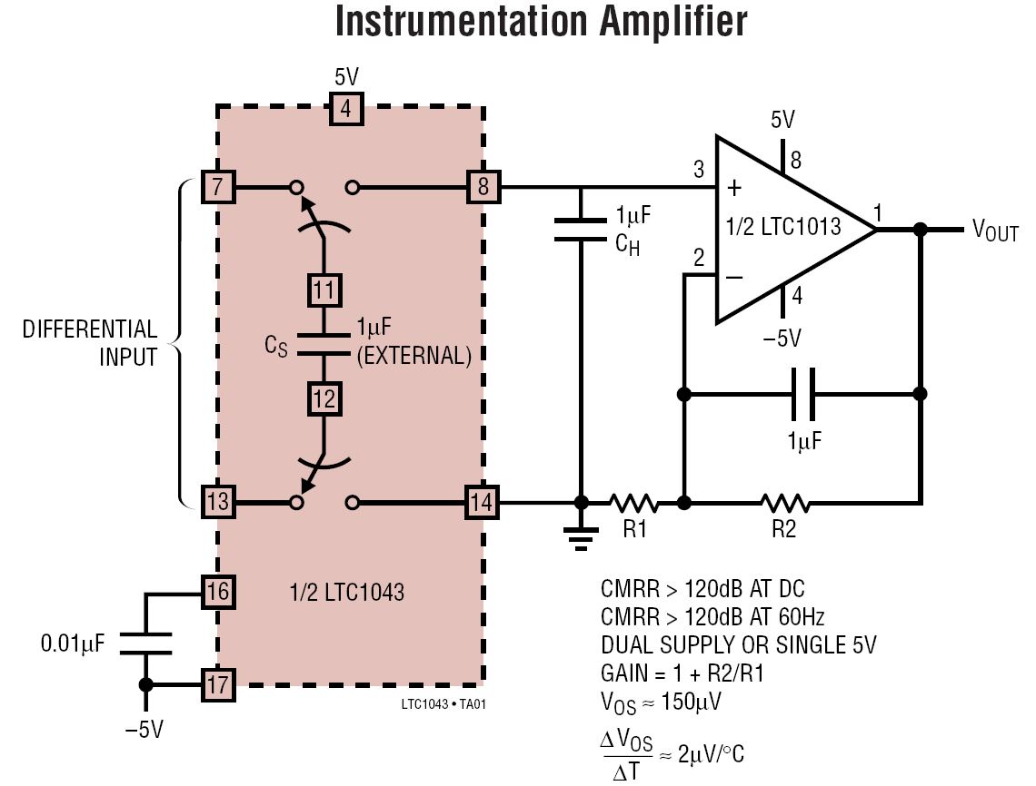
Bridge Conditioning Examples
Solution #1:
Drive the bridge so that CM voltage = 0
Need a negative supply
Source: Linear Technology AN-43
Solution #2:
Use a very high CMRR instrumentation amplifier
Many others in Linear AN-43…
Source: Datasheet LT1043
Notes:
Who can tell me the function of the transistor?
Integrator to avoid DC offset (like in a PID controller)
Or can use a high CMRR amplifier – explain principle.

Slide 24
Indirect Measurements of Blood Pressure
Non-invasive measurement of intra-arterial pressure
Ideally systolic, diastolic and mean arterial pressure
Two main methods for point measurements:
  Auscultatory
  Oscillometric
Alternative
  Ultrasound
  Tonometry
Continuous, non-invasive measurement remains a Holy Grail!
Notes:
Reminder: mean arterial pressure is the equivalent pressure required for a given cardiac output (flow) and a arterial resistance (TPR). Also approximated by DP+1/3(SP-DP).

Slide 25

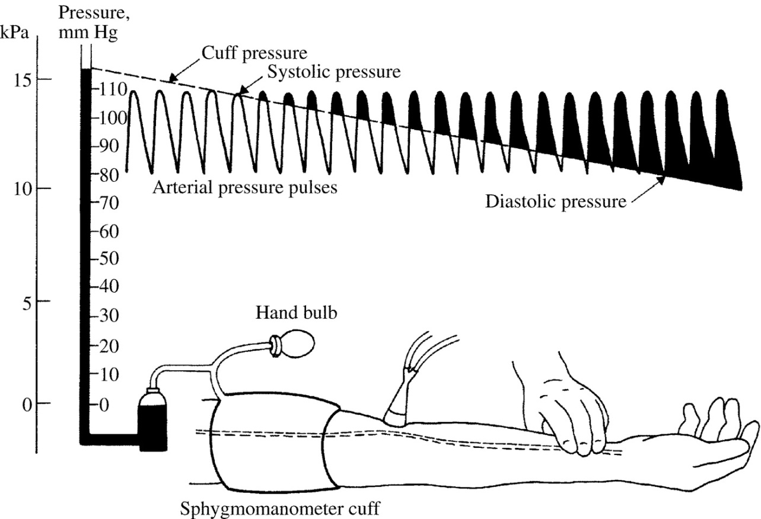
Auscultatory Method
Standard manual method
Uses Korotkoff sounds to detect systolic and diastolic pressures.
Pressure in the cuff is equal to pressure in the arm:
Cuff > BP_{sys}
No flow – no sound
BP_{sys} > Cuff > Bp_{dia}
Restricted flow (turbulence) – sound
Cuff < Bp_{dia}
Unimpeded flow – no sound
Source: Medical Instrumentation, J. Webster, Wiley, 2009
Notes:
Based on the fact that a semi-closed artery generates turbulences.
Can be automated with a digital stethoscope, but not very reliable (ambient noise). Also, some people do not have loud Korotkoff sounds.

Slide 26
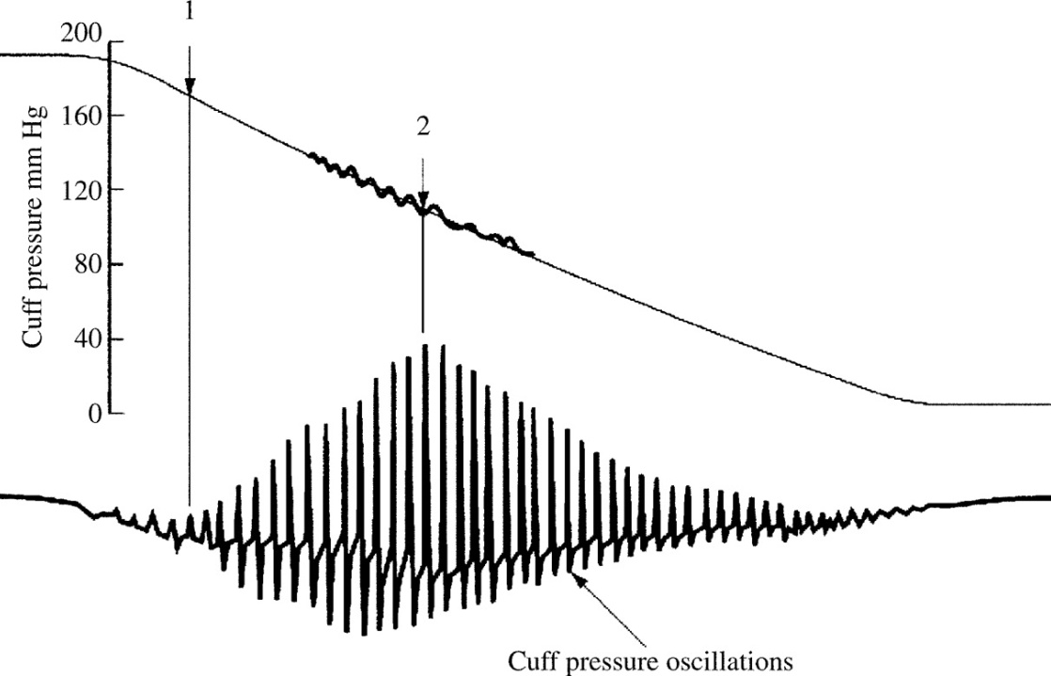
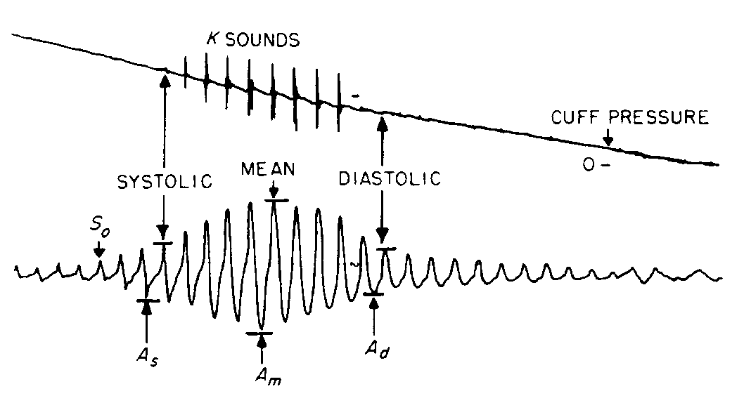
Oscillometric Method
For automated measurements, oscillometric, pressure-based method is preferred (less susceptible to noise).
As the cuff deflates, pressure oscillations transmitted to the cuff are recorded and analyzed.
Onset (systolic) and offset (diastolic) are estimated based on proprietary algorithms.
Comparison of Auscultatory and Oscillometric methods:
AC component
Source: Cardiovascular devices and their applications, Geddes, Wiley, 1984
Source: Medical Instrumentation, J. Webster, Wiley, 2009
Notes:
Point two is mean arterial pressure.
Method derived from Ocular tonometry. First proposed by Pressman and Newgard in 1963 while at the Stanford Research Institute.

Slide 27
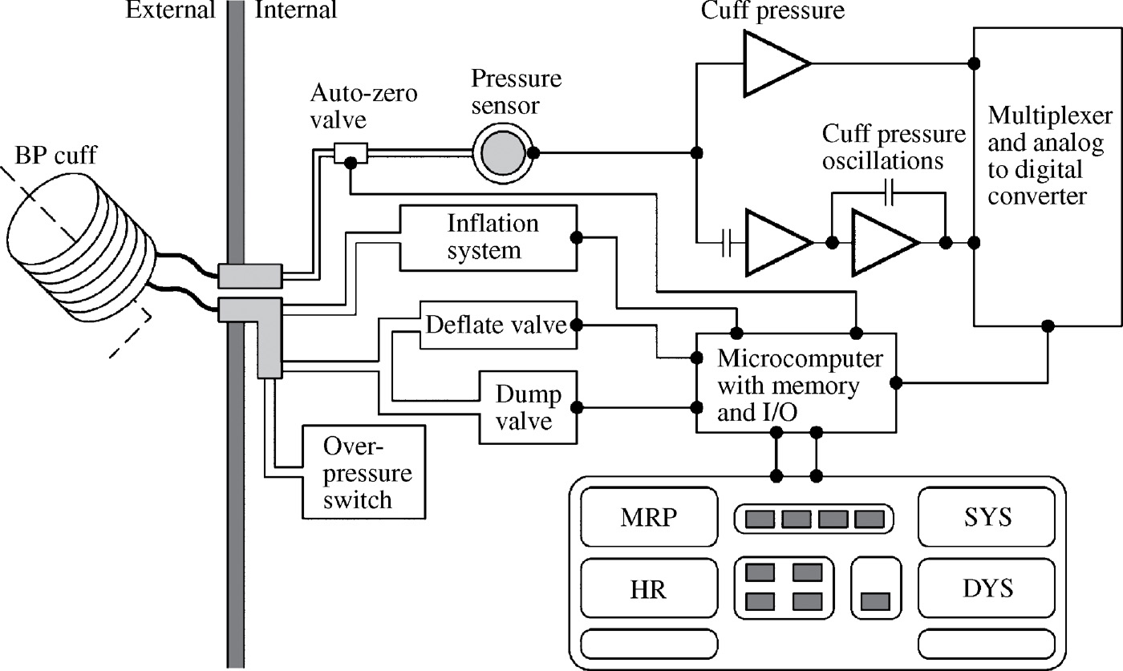
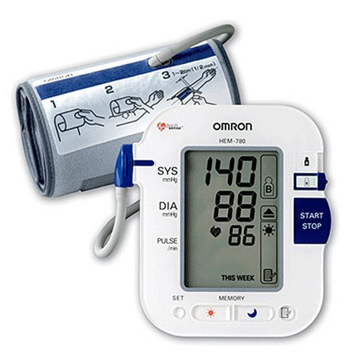
Oscillometric Blood Pressure Cuff
Project Idea !
Typical architecture of an automated oscillometric blood pressure monitor
Omron HEM-780 Automatic Blood Pressure Monitor
Source: Medical Instrumentation, J. Webster, Wiley, 2009

Slide 28
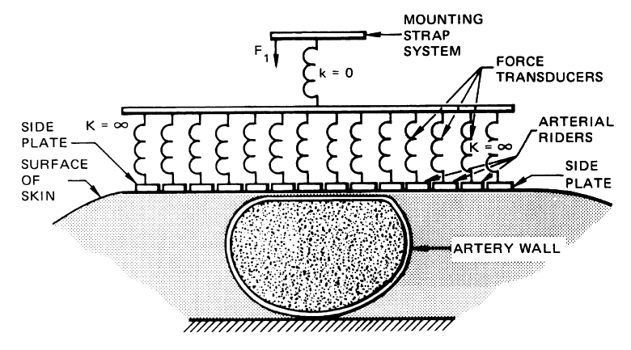
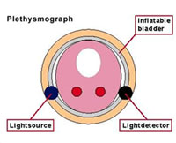
Other Methods
Doppler Ultrasound
Similar to auscultatory, but using Doppler ultrasound to detect vibration of artery and blood.
Arterial tonometry
The pressure applied on the artery to
flatten it equals the pressure inside the
artery.
Volume clamp (Peñáz method)
With a finger cuff, clamp the blood volume by
adjusting continuously the pressure based on
photoplethysmograph signal. The ‘correction’
follows the arterial pressure.
Source: FinaPres & Eckerle, Arterial Tonometry, Encyclopedia of Medical Devices
Notes:
Tonometry: only peripheral
Volume clamp – PPG, but with a direct readout of the pressure necessary to keep the volume constant (similar to keep the surface flat in tonometry). If only PPG, cannot know the pressure because it depends on the ubkown elasticity of the arteries.

Slide 29
Blood Flow & Volume
Measurements
Notes:
The two oftentimes go together since one is the integral of the other over time
Also, remember that flow and pressure are inter-related, although in a complex manner (time-varying resistance, compliance,…)

Slide 30
Blood Flow Measurements
Critical to know pumping efficacy and, by extension, oxygen and nutrients supply to the tissues.
Can assess global (cardiac output) or local flow (single blood vessel).
Invasive methods
  Continuous or pulse dilution methods
  Extravascular flowmeters
  Intravascular flowmeters
Non-invasive measurements
  Continuous blood-pressure-derived
  Impedance-derived
  Ultrasound (echocardiography)
  Others (e.g. ballistocardiography)
Notes:
Renal flow can only

Slide 31
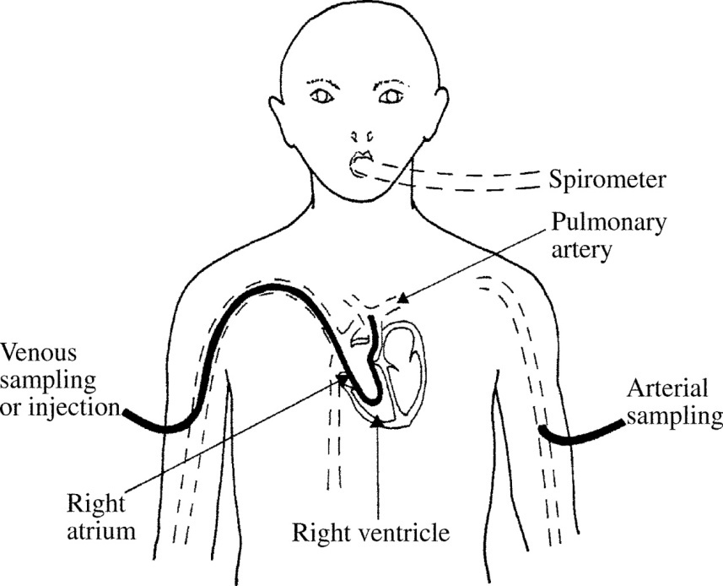
Global Flow - Fick’s Method
Gold standard for Cardiac Output (CO) measurement.
Oxygen is continuously added to the blood stream through the lungs, and concentration difference between pulmonary vein (pre-oxygenation) and artery (post-oxygenation) is measured.
→ The higher the flow, the higher the difference.
Can also be done by injecting a bolus of dye (dye dilution) or cold saline (thermodilution, most common), in which case the formula considers the integral of the concentration difference.
Fick’s method:
O₂
F: Blood flow
dm/dt: O₂ intake flow (VO₂)
(from spirometer)
ΔC: O₂ concentration difference
in blood stream
Source: Medical Instrumentation, J. Webster, Wiley, 2009
Notes:
Only measure average flow.
Thermodilution: cold bolus injected in right atria. Temp measured in pulmonary artery.
Dye: indocyanide green (fluorescent)
In preparation for thermodilution, a multiple lumen pulmonary artery catheter (PAC) is passed
through the skin into a central vein. Once the catheter tip reaches a central venous location, a
balloon at the tip is inflated, which causes the catheter tip to rapidly move from the right atrium,
through the right ventricle, and into the pulmonary artery. A bolus of room temperature or iced
(0◦C) 5% dextrose in water or 0.9% NaCl is injected through the catheter into the right atrium.
The volume injected in adult patients, that are not fluid restricted, is generally 10 ml. The
resulting blood temperature transient is detected downstream by a thermistor in the pulmonary
artery.
Cardiac output is then calculated using the Stewart–Hamilton equation as
CO =
VI (TB − TI)K1K2/A
where VI is the injectate volume, TB is the blood temperature in the pulmonary artery, TI
is the injectate temperature, K1 is the density factor (injectate/blood), K2 is the catheter
manufacturer’s computation constant, and A is the area under the thermodilution curve.

Slide 32
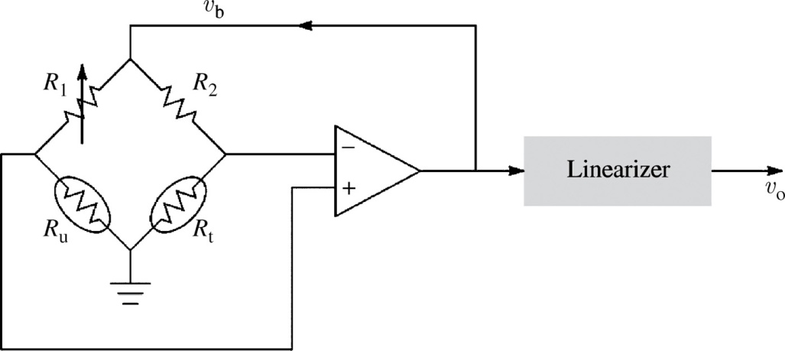
Intravascular Flowmeters
Measures instantaneous flow in blood vessel.
Requires catheterization.
Most common type: thermal flow meter
  A heated thermistor will see its temperature fluctuates with flow (higher flow, cooler temperature).
  A second thermistor can be used for measuring direction or compensate for blood temperature change.
  Highly non-linear (large signals at low flow).
  Constant-temperature mode avoid overheating and increase bandwidth (DC-25 Hz):
Can be used with or without right side (reference thermistor to balance for blood temperature change)
Source: Medical Instrumentation, J. Webster, Wiley, 2009
Notes:
In the diagram, can be used either with only Ru (if Ru goes up as temp down because flow high), then feedback to boost current so Ru is back at temperature.
Negative feedback extend bandwidth similarly to an opamp.
Rt can balance bridge of overall blood temperature changes (needs to be much slower than Ru
Increased bandwidth
Tricky to position in vessel, so measuring max flow.

Slide 33
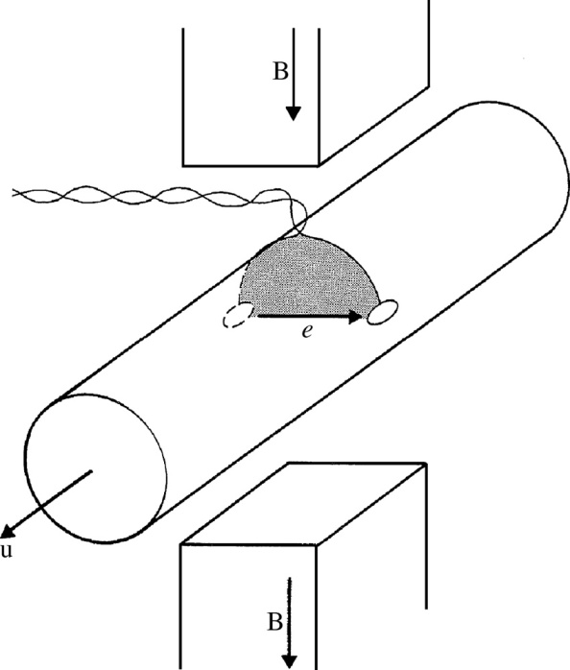
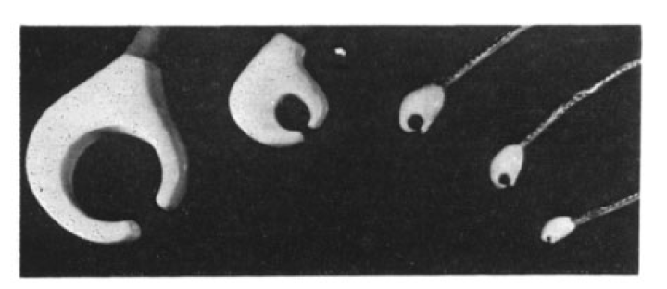
Extravascular Flowmeters
Measure instantaneous flow in blood vessels.
Most common type: electromagnetic flow meter
  Induced emf from moving conductor (blood) in a magnetic field (Faraday’s Law of induction).
  Usually used with AC fields (100-500Hz).
  Gated measurement or quadrature-
  suppression to reduce parasitic
  transformer voltage (90° out-of-phase).
Source: Medical Instrumentation, J. Webster, Wiley, 2009 & Wyatt, J Scientific Instrument, 1968
Notes:
Why AC fields?
Because DC would generate a DC emf which would be difficult to measure with electrodes (polarization). Also, low frequency are overwhelmed by ECG component.
Emf induced by transformer loop is 90deg out of phase with emf due to blood, so easy to tease apart.
Transformer voltage: voltage generated in the loop by the AC field if the loop is not perfectly perpendicular to magnet. This voltage is proportional to derivative, hence is 90deg out-of-phase.

Slide 34
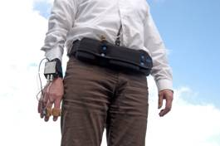
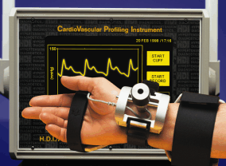
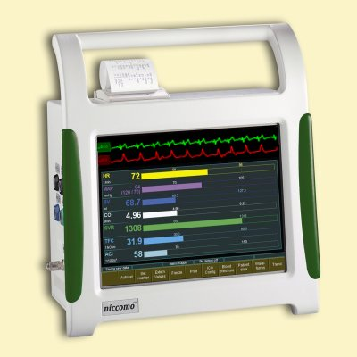
Alternate Blood Flow Measurements
Many indirect methods for CO measurements have been proposed based on:
  Continuous blood pressure measurement (volume clamp or arterial tonometry)
  Impedance cardiography (ICG)
While they are adequate for trends and healthy subject (where models work well), they are not as robust as invasive methods.
An interesting example: ballistocardiogram.
FMS PortaPres®
HDI/PulseWave™ CR-2000
Niccomo ICG
Notes:
Blood pressure based uses pulse contour analysis.
If resistance was constant, would be easy: F = ΔP/R. But it is not the case, so need for models which have limitations.

Slide 35
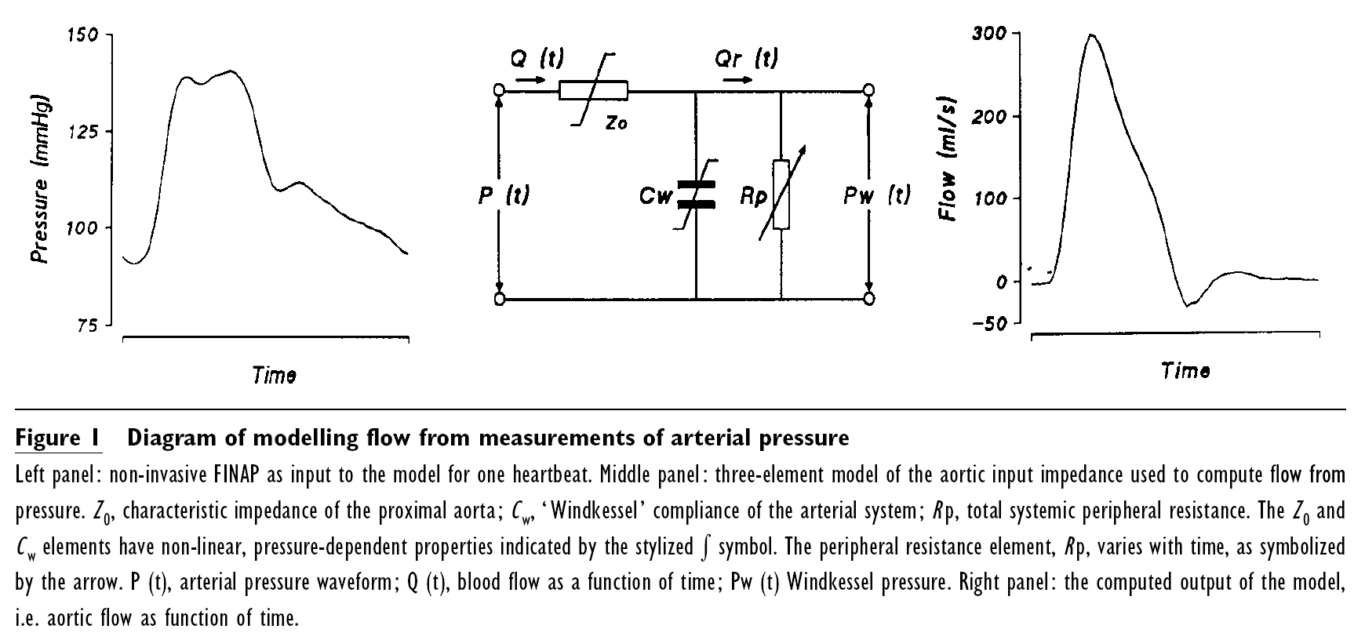
Pressure → Flow (ModelFlow®)
Using a model of the compliant arteries, it is possible to estimate the flow at the aorta from the pressure measured at the fingers.
Source: Continuous stroke volume monitoring by modeling flow from non-invasive measurement of arterial pressure in humans under orthostatic stress, M.P. M. HARMS, et al., Clinical Science (1999) 97, 291–301.
Notes:
ModelFlow: model used in FMS PortaPres and FinaPres continuous blood pressure system to estimate stroke volume.

Slide 36
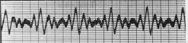
Ballistocardiography (BCG)
Measurement of the minute forces imparted by the pulsatile blood flow on the body.
BCG
Mandelbaum, et al., 1953: “Improved” BCG for post-infarct subjects correlated to good recovery.
ECG
Commercial BCG recorder, 1952, $25,000 (2008 currency), Circ., p. xxxix, 1952

Slide 37
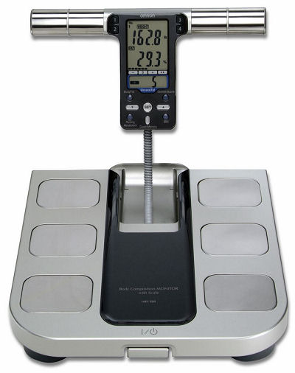
Scale-based Ballistocardiogram
N
N
V
N
N
V
N
N
N
ECG
ECG (V)
N
N
N
N
N
N
N
BCG
BCG (N)
V
V
Premature ventricular contractions as seen in the electrocardiogram (ECG) and ballistocardiogram (BCG).
Omron HBF-500
Simultaneous Cardiac Output (Doppler) and BCG during exercise recovery
R² = 0.85 (p << 0.001)
N = 10 Trials
n = 275 Data Points
Courtesy of O.T Inan (Physiological Measurements, 30 (2009)

Slide 38
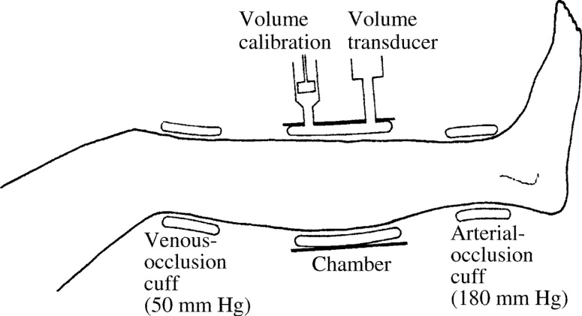
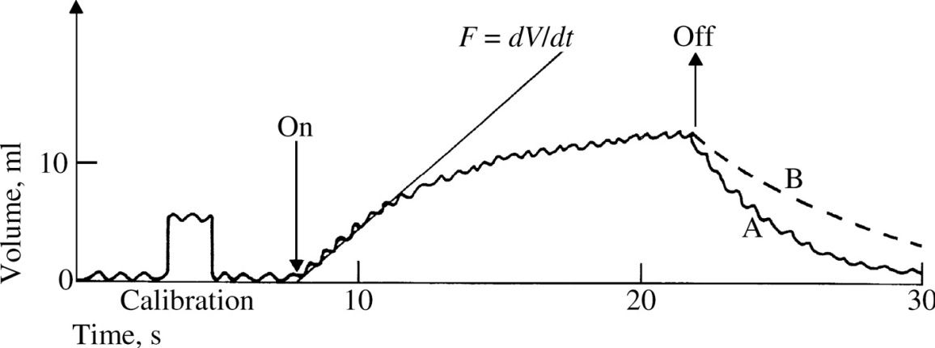
Volume Measurements
Volume measurement = Plethysmography
Can be measured:
  Mechanically (chamber plethysmography)
  Electrically (impedance plethysmography)
  Seen in Tissue Impedance lecture
  Optically (photoplethysmography, PPG)
Sometimes used with cuffs to separate arterial from venous flows:
  Venous occlusion in leg:
  50 mmHg
  Arterial occlusion in leg:
  180 mmHg
Example of chamber plethysmography
Source: Medical Instrumentation, J. Webster, Wiley, 2009
Notes:
After venous occlusion started, then arterial blood starts to pool in the leg at a speed related to in-flow.
Blocking arterial at the foot effectively block arterial flow in the whole leg, but let the venous flow intact

Slide 39
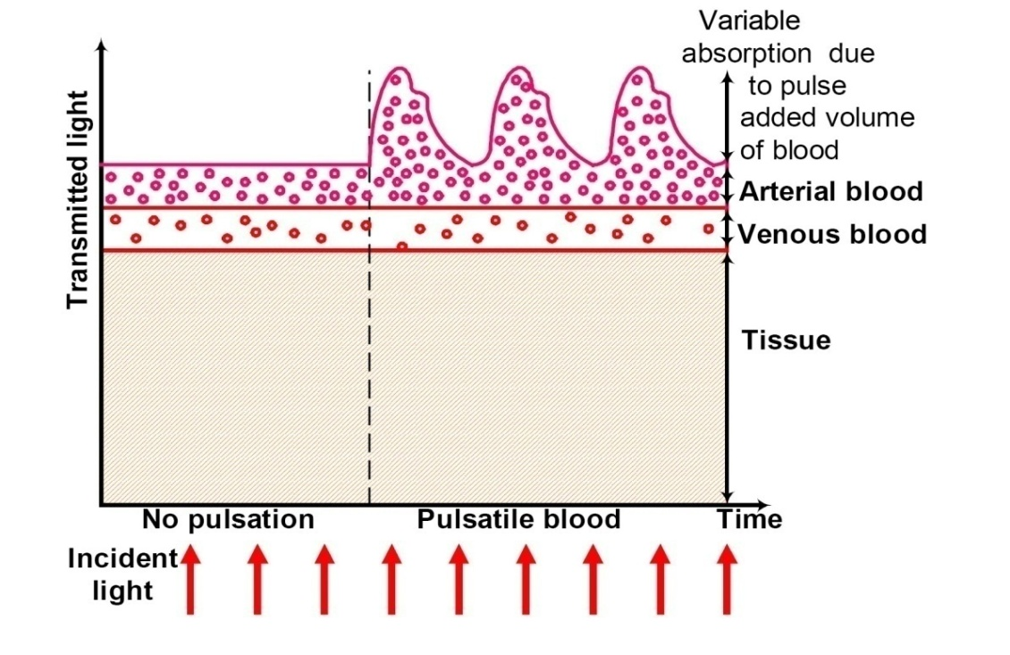
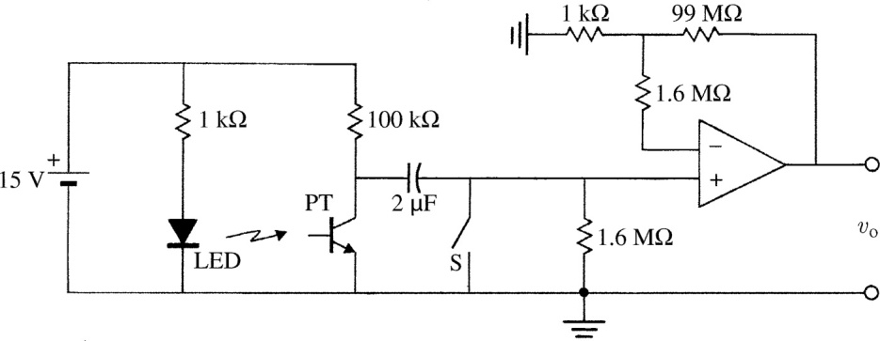
Photoplethysmography (PPG)
Light (red, infrared) absorption is modulated by the volume of blood in the light path.
Volume of blood modulated by the pressure pulse wave.
Done in Lab!
Transmitted light though a finger
Basic PPG circuit
Source: Cypress Semiconductor App Note AN2313 & Webster
Notes:
Need to beef up this slide for next year
Red is chosen because of minimal absorption by water, hence good penetration depth.
Can anyone tell me why 1.6Mohm in the feedback loop?

Slide 40


Pulse Oximeter
Measure the saturation of oxygen in peripheral blood (SpO₂).
Percentage of oxyhemoglobin (oxygen-carrying hemoglobin) relative to total hemoglobin.
Indicative of oxygen delivery capabilities.
Measured by taking the ratio of two wavelength absorptions:
  Red (660nm): preferential absorption by deoxyhemoglobin (Hb).
  Infrared (940nm): preferential absorption by oxyhemoglobin (O₂Hb).
Use blood pulsation to extract blood-related absorption from other source of absorptions (nail polish, skin,…):
Ratio of normalized modulated (AC) absorption with respect to constant (DC) absorptions, for IR and Red:
This ratio can then be calibrated to SpO2.
Commercial Pulse Oximeter (source: Nonin)
Notes:
At low partial pressures of oxygen, most hemoglobin is deoxygenated. At around 90% (the value varies according to the clinical context) oxygen saturation increases according to an oxygen-hemoglobin dissociation curve and approaches 100% at partial oxygen pressures of >10 kPa (wiki)

Slide 41
Acoustic Measurements
Measurements
Notes:
Stopped here

Slide 42
Acoustic Measurements
Sounds are related to pressures and flow:
  Valve closing generate some noise due to rapid deceleration of blood.
  Turbulent flow generates characteristic sounds (Korotkoff sounds, murmurs).
  In lungs, turbulent flows due to restricted airways (wheezing), and alveolar opening (crackles) also lead to particular sounds.
Of great importance for diagnostics (valvular defects, stenosis, hypercardiomyopathy, asthma, pneumonia,…)
Typically measured with stethoscope…
…but also with other pressure and acceleration sensors.
Large bandwidth of 0.1-2000 Hz, although most power is concentrated in the 10-400 Hz region.
Notes:
Murmurs are due to leakage in the heart valves

Slide 43
Heart Sounds
S1 (‘Lub’): Closure of Mitral and tricuspid valves
Split sound: valves do not close at the same time
S2 (‘Dub’): Closure of aortic and pulmonary valves
Split: same as for S1
S3, S4 (Gallop sounds): Vibration of ventricles walls due to free (S3) and pushed (S4) inflow from atria.
Murmurs: Turbulent flow
S4
S1
S2
S3
Source: Medical Instrumentation, J. Webster, Wiley, 2009
Notes:
first (SI) heart sound (HS) is associated with closure ofthe mitral valve but as the valve leaflets are tissue thin, other mechanical factors associated with the closure of the valve are believed to account for the audible sounds. These include the oscillation of blood in the ventricular chambers, vibration of the chamber walls, abrupt tensing of the chordae tendinae supporting the mitral valve leaflets and tensing of the mitral valve itself.

Slide 44
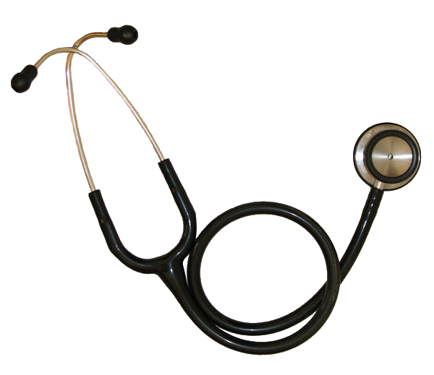
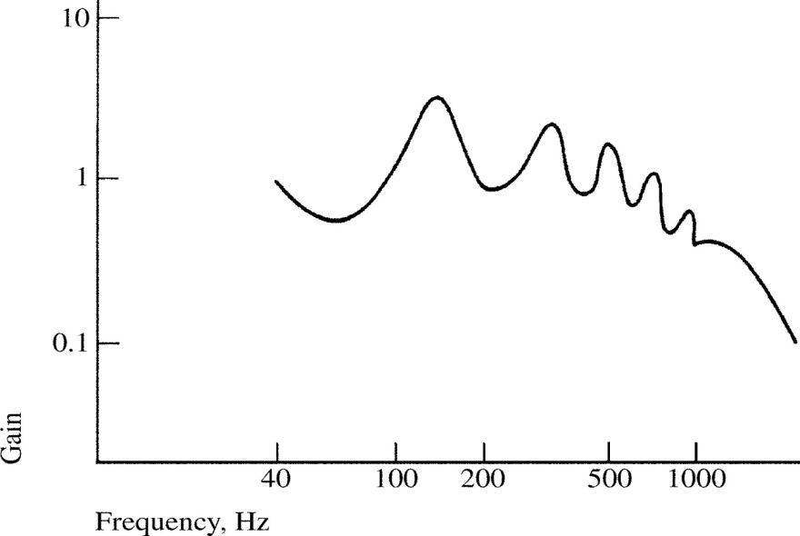
Classic Stethoscope
Invented by Laennec in 1816.
Mechanical amplification resulting of standing wave at quarter-wavelength (~80 cm at 100Hz).
Tube length matter !
Uneven frequency response:
Can be interfaced with a microphone, but not optimal.
Classic 3M™ Littmann® stethoscope
Source: Medical Instrumentation, J. Webster, Wiley, 2009

Slide 45
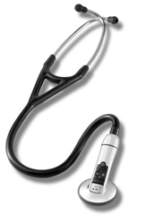
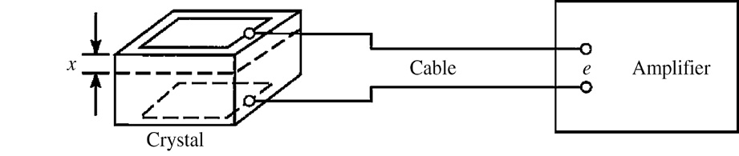
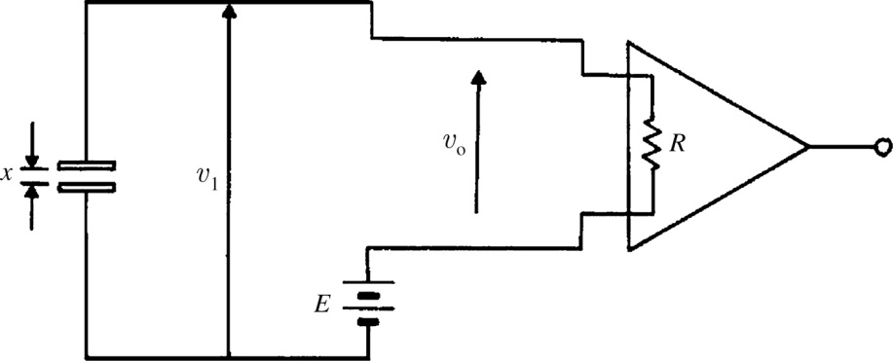
Phonocardiography (PCG)
Phonocardiography is the recording and analysis of heart sounds.
Can be performed with most modern digital stethoscope.
Usually uses direct transduction methods (no tube).
Increased, flatter frequency response.
Transduction include capacitive, piezoelectric
methods.
Electronic 3M™ Littmann® stethoscope
Charge amplifier
Piezoelectric sensing: movement of plates generates charges
Capacitive sensing: movement of plates modulates charges
One plate/side is attached to the chest, the other to the (fixed) stethoscope body.

Slide 46
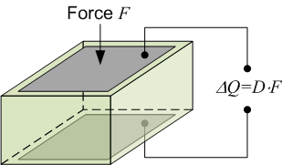
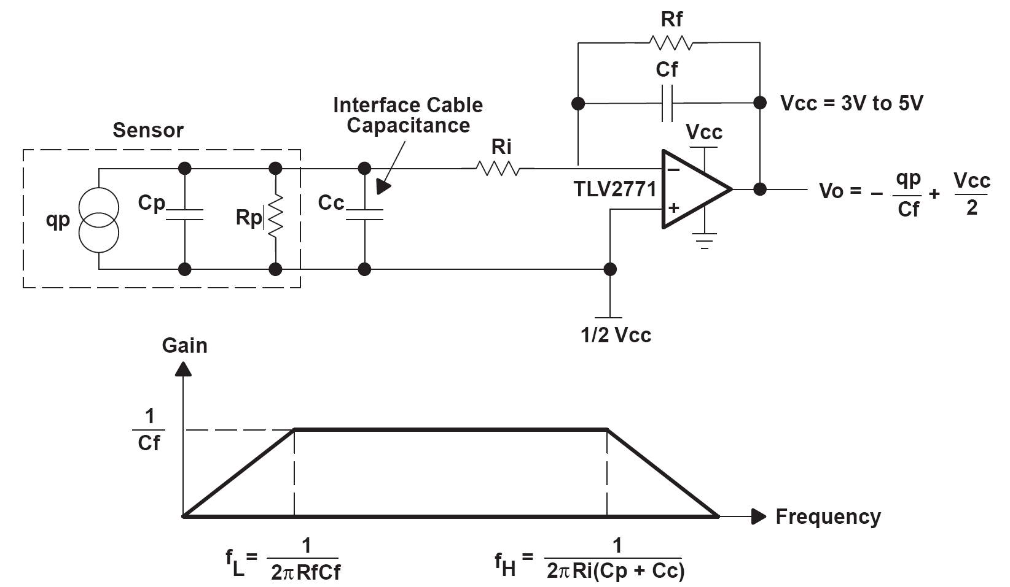
Piezoelectric Sensor Interface
Piezoelectric materials (quartz, PZT, PVDF,…) generate a charge proportional to the applied stress/force. They are not suitable for DC measurements (leakage).
Piezoelectric sensor modeled as a charge source, conditioned by a charge amplifier:
C_{p}
D=6-7 pC/N for PVDF
H
f
C_{p}
Voltage-source equivalent
V_{eq}
C_{p}
Current-source equivalent
I_{eq}
Extensively used in phonocardiography, Korotkoff sounds detection,…
Source: Texas Instruments – Application Report SLOA033A
Notes:
Charge amplifiers are better suited than voltage amplifier because they are less sensitive to parasitic capacitances. (check app report for that).
Notice the single supply implementation
Outside of the linear region, the piezo behaves like a RLC circuit, with a resonant frequency, and a high-pass effect.
Piezo sensors are sometimes found integrated with a FET transistor to buffer the signal and provide a low output impedance signal.
Can also make nice accelerometers (often used in pacemaker, since does not require power)
For next year – add capacitive sensor too. Look at circuit from Horowitz and Hill, p. 1003
Strain causes a redistribution of charges and results in a net electric dipole

Slide 47
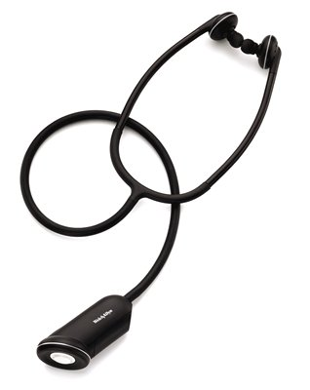




Electronic Stethoscopes
Welch-Allyn Master Elite Plus
Thinklabs ds32a
Piezoelectric (PVDF) sensor
20Hz-20kHz bandwidth
Electromagnetic (capacitive?) sensor, 15-400 Hz bandwidth
Notes:
Show the inovise sensor too.
Thinklabs – get higher bandwidth, but

Slide 48


Seismocardiography (SCG)
Seismocardiography is the measurement of the vibration of the chest.
Equivalent to phonocardiography if frequency response is high enough.
MEMS 3-axis accelerometer
Courtesy of Keya Pandia
Notes:
Plenty of other cardi0graphy (apex, …)
Data taken with ST Microelectronics 3-axis accel (LIS3L02AL, 3-axis, +/- 2g)

Slide 49
Photoplethysmography (PPG)
Lab this week

Slide 50

Get familiar with this chip…

